Slide 1

Scope of Disclosure | TSIP Team
Confidential period | Indefinite
Head of information owner section | Training Division Head
Handling restriction | “No Copying” , “No Printing” “No transferring”, “No re-disclosure” “No circulation” , “Do not duplicate”
Classes : Part 1

Slide 2



UML 2.5 discussions have been known to cause or induce sleep among participants.
Necessary precautions to prevent injuries due to participants falling off chairs ,resulting from UML-induced stupor is highly advised ☺
Please do not fall off the chair !

Slide 3
Common Structure

Slide 4
Elements
The root concepts of Element and Relationship provide the basis for all other modeling concepts in UML.
Every Element has the inherent capability of owning other Elements
Every kind of Element may own Comments
A Relationship is an Element that specifies some kind of relationship between other Elements
A DirectedRelationship represents a Relationship between a collection of source model elements and a collection of target model elements
A DirectedRelationship is said to be directed from the source elements to the target elements

Slide 5
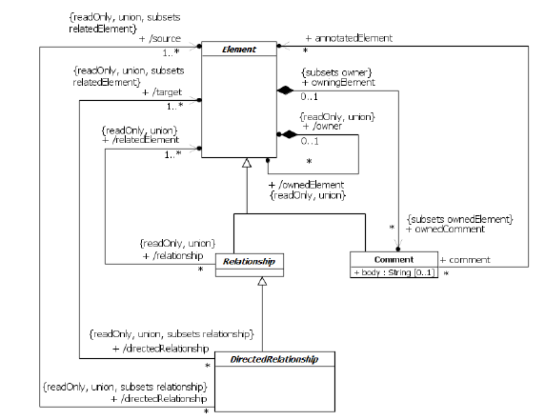
Abstract Syntax *
Recommendation : Please decipher this diagram only after understanding the semantics of each of the participating elements.

Slide 6
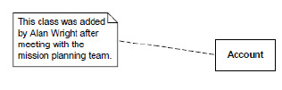
Comments
Comment is a textual annotation that can be attached to a set of Elements

Slide 7
Namespaces
A Namespace is an Element in a model that contains a set of NamedElements that can be identified by name
Packages are Namespaces whose specific purpose is to contain other NamedElements in order to organize a model
Other namespaces include Classifiers containing named Features and nested Classifiers, and BehavioralFeatures which contain named Parameters.

Slide 8
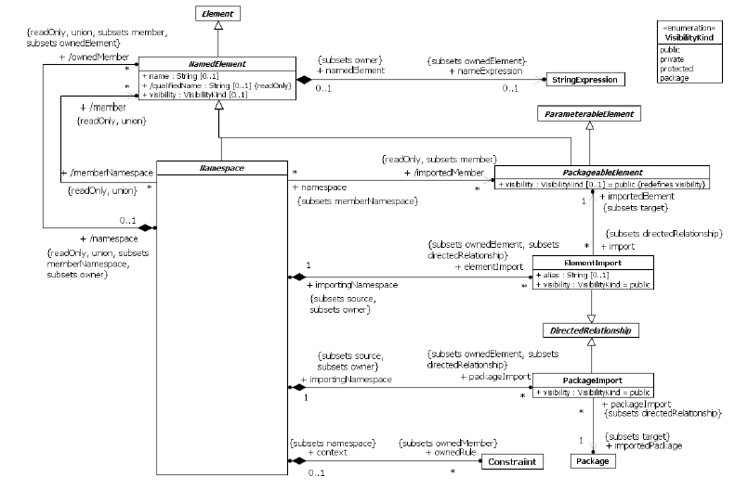
Abstract Syntax *
Recommendation : Please decipher this diagram only after understanding the semantics of each of the participating elements.

Slide 9
Namespaces
A Namespace provides a container for NamedElements, which are called its ownedMembers
A Namespace may also import NamedElements from other Namespaces, in which case these, along with the ownedMembers, are members of the importing Namespace.
If a member of a Namespace with the name N is a NamedElement with the name x, then the member can be referred to by a qualified name of the form N::x.
Within a Namespace, unqualified names may be used to refer to the members of that Namespace and to outer names that are not hidden. An outer name is the name of a NamedElement that may be referenced using an unqualified name in an immediately enclosing Namespace. An outer name is hidden unless it is distinguishable from all members of the inner Namespace.

Slide 10
Namespaces
As a Namespace is itself a NamedElement, the fully qualified name of a NamedElement may include multiple Namespace names, such as N1::N2::x.

Slide 11
Namespaces
A NamedElement is an Element in a model that may have a name.
The name may be used for identification of the NamedElement within Namespaces where its name is accessible.
NamedElements may appear within a Namespace according to rules that specify how one NamedElement is distinguishable from another
The default rule is that two members are distinguishable if they have different names or if they have the same names, but their metaclasses are different and neither is a (direct or indirect) subclass of the other
This rule may be overridden for particular cases, such as Operations that are distinguished by their signature

Slide 12
Namespaces
Visibility of a NamedElement provides a means to constrain the usage of the Element, either in Namespaces or in access to the Element
A NamedElement may, in addition to having an explicit name, be associated with a StringExpression that may be used to specify a calculated name for the NamedElement.
A NamedElement may have both a name and a nameExpression associated with it.
A PackageableElement is a NamedElement that may be owned directly by a Package
An ElementImport is a DirectedRelationship between an importing Namespace and a PackageableElement
It adds the name of the PackageableElement to the importing Namespace.

Slide 13
Namespaces
In case of a name clash with an outer name (an element that is defined in an enclosing Namespace that is available using its unqualified name in enclosed Namespaces) in the importing Namespace, the outer name is hidden by an ElementImport, and the unqualified name refers to the imported element. The outer name can be accessed using its qualified name.

Slide 14
Package Import
A PackageImport is a DirectedRelationship between an importing Namespace and a Package, indicating that the importing Namespace adds the names of the members of the Package to its own Namespace.
Conceptually, a Package import is equivalent to having an ElementImport to each individual member of the imported Namespace.

Slide 15
Package Import
If indistinguishable Elements would be imported into a Namespace as a consequence of ElementImports or PackageImports, the Elements are not added to the importing Namespace and the names of those Elements must be qualified in order to be used in that Namespace.
If the name of an imported Element is indistinguishable from an Element owned by the importing Namespace, that Element is not added to the importing Namespace and the name of that Element must be qualified in order to be used.

Slide 16
Package Import
A Namespace may not import itself, nor may it import any of its own ownedMembers
A PackageImport or ElementImport is shown using a dashed arrow with an open arrowhead from the importing Namespace to the imported Package or Element
The keyword «import» is shown near the dashed arrow if the visibility is public; otherwise, the keyword «access» is shown to indicate private visibility

Slide 17
Package Import
The textual syntax for a PackageImport is:
‘{import ’ <qualified-name> ‘}’ | ‘{access ’ <qualified-name> ‘}’
The textual syntax for an ElementImport is:
‘{element import’ <qualified-name> ‘}’ | ‘{element access ’ <qualified-name> ‘}’
With alias :
‘{element import ’ <qualified-name> ‘ as ’ <alias> ‘}’ | ‘{element access ’ <qualified-name> ‘as’ <alias> ‘}’

Slide 18
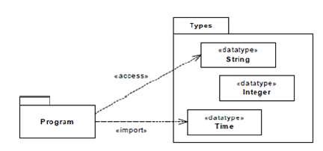
Element Import
The ElementImport allows Elements in the Package Program to refer by name to the DataType Time in Types without qualification. However, they still need to refer explicitly to Types::Integer, as this Element is not imported.
The DataType String is imported into the Program Package but it is not a publicly visible as a member of Program outside of that Package, and it cannot be further imported from the Program Package by other Namespaces

Slide 19
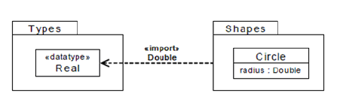
Element Import : Aliasing
The ElementImport is combined with aliasing, meaning that the DataType Types::Real will be referred to by name as Double in the package Shapes.

Slide 20
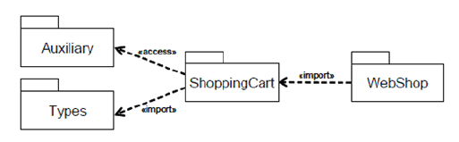
Package Imports : Public and Private
The public members of Types are imported into ShoppingCart and then further imported into WebShop.
However, the members of Auxiliary are only privately imported by ShoppingCart and cannot be referenced using unqualified names from WebShop.

Slide 21
Type
A Type specifies a set of allowed values known as the instances of the Type
A TypedElement is a NamedElement that, in some way, represents particular values
ValueSpecification, which directly specifies a collection of values
StructuralFeature, which represents values held as part of the structure of the instances of the Classifier that owns it
A TypeElement with no associated Type may represent any value

Slide 22
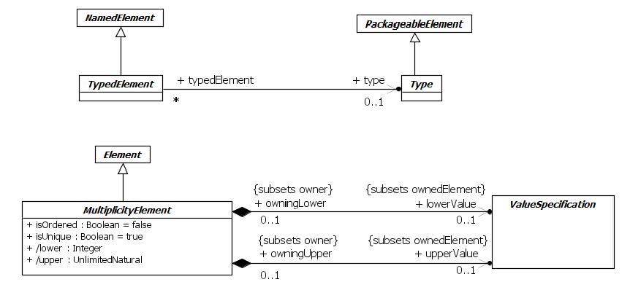
Multiplicity
Types and multiplicity are used in the declaration of Elements that contain values, in order to constrain the kind and number of values that may be contained.

Slide 23
Multiplicity
A MultiplicityElement is an Element that may be instantiated in some way to represent a collection of values
The values in the collection may change over time
The cardinality of a collection is the number of values contained in that collection.
The multiplicity of a MultiplicityElement specifies valid cardinalities of the collection it represents.
The multiplicity is a constraint on the cardinality, which shall not be less than the lower bound and not greater than the upper bound specified for the multiplicity

Slide 24
Multiplicity
The lower and upper bounds for the multiplicity of a MultiplicityElement are specified by ValueSpecifications, which must evaluate to an Integer value for the lowerBound and an UnlimitedNatural value for the upperBound
A MultiplicityElement is unlimited if its upperBound has the UnlimitedNatural value of unlimited (“*”).
A MultiplicityElement is multivalued if it has an upperBound greater than 1 (including unbounded). A MultiplicityElement that is not multivalued can represent at most a single value.
A MultiplicityElement can define a multiplicity both of whose bounds are zero. This restricts the allowed cardinality to be 0; that is, it requires that an instantiation of this element contain no values
(context of Generalizations to constrain the cardinalities of a more
general Classifier )

Slide 25
Multiplicity
If the MultiplicityElement is specified as ordered (i.e., isOrdered is true), then the collection of values in an instantiation of this Element is ordered
mapping from positive integers to the elements of the collection of values
If a MultiplicityElement is not multivalued, then the value for isOrdered has no semantic effect
If the MultiplicityElement is specified as unordered (i.e., isOrdered is false), then no assumptions can be made about the order of the values in an instantiation of this Element.
If the MultiplicityElement is specified as unique (i.e., isUnique is true), then the collection of values in an instantiation of this Element must be unique
That is, no two values in the collection may be equal,
where equality of objects (instances of Classes) is based on object identity
while equality of data values (instances of DataTypes) and Signal instances is based on value
If a MultiplicityElement is not multivalued, then the value for isUnique has no semantic effect.

Slide 26
Multiplicity
The multiplicity bounds may be shown in the format:
<lower-bound> ‘..’ <upper-bound>
where <lower-bound> is a ValueSpecification of type Integer and <upper-bound> is a ValueSpecification of type UnlimitedNatural. The star character (*) is used as part of a multiplicity specification to represent an unlimited upper bound.
If the lower bound is equal to the upper bound, then an alternate notation is to use a string containing just the upper bound. For example, “1” is semantically equivalent to “1..1” multiplicity.
A multiplicity with zero as the lower bound and an unspecified upper bound may use the alternative notation containing a single star “*” instead of “0..*” multiplicity.

Slide 27

Collection Types

Slide 28
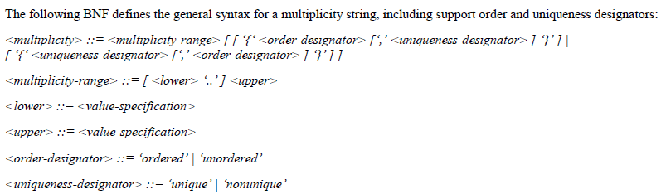
Multiplicity : Syntax

Slide 29
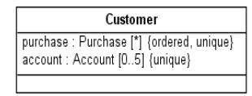

Multiplicity : Examples

Slide 30
Constraints
A Constraint is an assertion that indicates a restriction that must be satisfied by any valid realization of the model containing the Constraint.
A Constraint is attached to a set of constrainedElements, and it represents additional semantic information about those Elements.
The specification of a Constraint is given by a ValueSpecification of type Boolean
The context of the Constraint may be used as the Namespace for interpreting names used in the specification (“self” is used to refer to the context element)

Slide 31
Constraints
The owner of the Constraint determines when the Constraint specification is evaluated
a Constraint that is a precondition of an Operation is evaluated at the start of the invocation of the Operation,
a Constraint that is a postcondition is evaluated at the conclusion of the invocation
A Constraint is evaluated by evaluating its specification.
If the specification evaluates to true, then the Constraint is satisfied at that time. If the specification evaluates to false, then the Constraint is not satisfied, and the realization of the model in which the evaluation occurs is not valid.
BNF notation :
<constraint> ::= ‘{‘ [ <name> ‘:’ ] <boolean-expression> ‘ }’
where <name> is the name of the Constraint and <boolean-expression> is the appropriate textual notation for the Constraint specification.

Slide 32
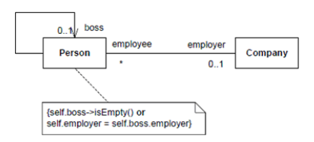
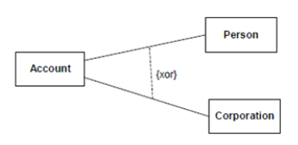
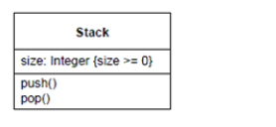
Constraints : Examples

Slide 33
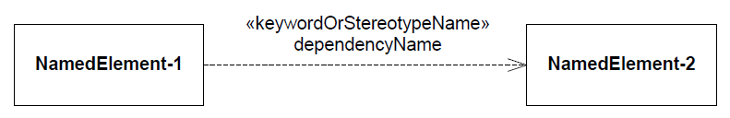
Dependencies
A Dependency signifies a supplier/client relationship between model elements where the modification of a supplier may impact the client model elements
Client
Supplier

Slide 34
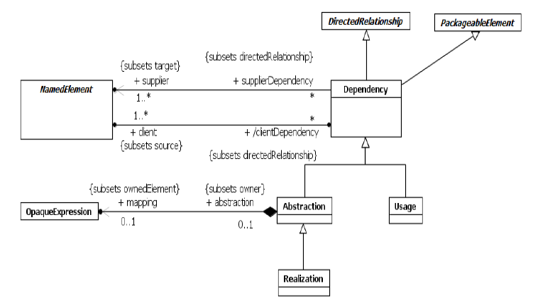
Abstract Syntax*
Recommendation : Please decipher this diagram only after understanding the semantics of each of the participating elements.

Slide 35
Dependencies
A Dependency implies that the semantics of the clients are not complete without the suppliers
The semantics are all given in terms of the NamedElements that participate in the relationship, not in terms of their instances
A Usage is a Dependency in which one NamedElement requires another NamedElement (or set of NamedElements) for its full implementation or operation

Slide 36
Abstraction
An Abstraction is a Dependency (relationship) that relates two NamedElements or sets of NamedElements that represent the same concept at different levels of abstraction or from different viewpoints
Depending on the specific stereotype of Abstraction, the mapping may be formal or informal, and it may be unidirectional or bidirectional.
Abstraction has predefined stereotypes (such as «Derive», «Refine», and «Trace») that are defined in the Standard Profile
For example, an analysis-level Class might be split into several design-level Classes

Slide 37
Realization
Realization is a specialized Abstraction dependency between two sets of NamedElements, one representing a specification (the supplier) and the other representing an implementation of that specification (the client).
A Realization signifies that the set of clients is an implementation of the set of suppliers, which serves as the specification.

Slide 38
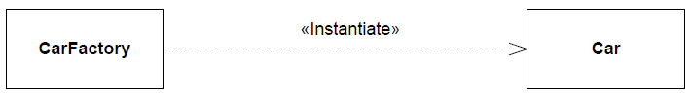
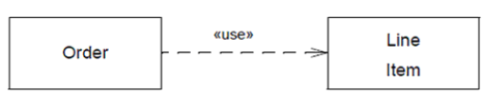
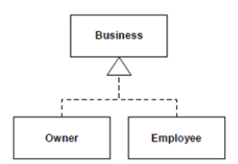
Dependencies: Examples

Slide 39
Summary
An Abstraction is a Relationship that relates two Elements or sets of Elements that represent the same concept at different levels of abstraction or from different viewpoints
Generalization : Dependency
Specialization : Realization, Manifestation
A Comment is a textual annotation that can be attached to a set of Elements
A Constraint is a condition or restriction expressed in natural language text or in a machine readable language for the purpose of declaring some of the semantics of an Element or set of Elements
The ValueSpecification for a Constraint must evaluate to a Boolean value.
Evaluating the ValueSpecification for a Constraint must not have side effects

Slide 40
Summary
A Dependency is a Relationship that signifies that a single model Element or a set of model Elements requires other model Elements for their specification or implementation.
This means that the complete semantics of the client Element(s) are either semantically or structurally dependent on the definition of the supplier Element(s).
A DirectedRelationship represents a relationship between a collection of source model Elements and a collection of target model Elements
An Element is a constituent of a model. As such, it has the capability of owning other Elements
An ElementImport identifies a NamedElement in a Namespace other than the one that owns that NamedElement and allows the NamedElement to be referenced using an unqualified name in the Namespace owning the ElementImport.

Slide 41
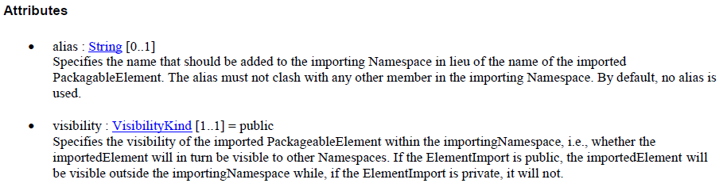
Summary
An ElementImport identifies a NamedElement in a Namespace other than the one that owns that NamedElement and allows the NamedElement to be referenced using an unqualified name in the Namespace owning the ElementImport.
A multiplicity is a definition of an inclusive interval of non-negative integers beginning with a lower bound and ending with a (possibly infinite) upper bound.
A MultiplicityElement embeds this information to specify the allowable cardinalities for an instantiation of the Element.

Slide 42
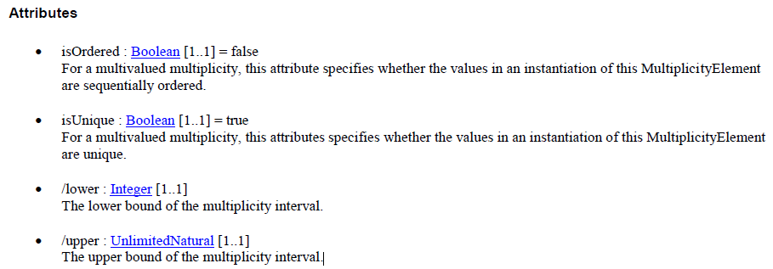
Summary
A NamedElement is an Element in a model that may have a name. The name may be given directly and/or via the use of a StringExpression
A Namespace is an Element in a model that owns and/or imports a set of NamedElements that can be identified by name.
Member : A collection of NamedElements identifiable within the Namespace, either by being owned or by being introduced by importing or inheritance.
OwnedMember : A collection of NamedElements owned by the Namespace.
ImportedMember :References the PackageableElements that are members of this Namespace as a result of either PackageImports or ElementImports.

Slide 43
Summary
A PackageImport is a Relationship that imports all the non-private members of a Package into the Namespace owning the PackageImport, so that those Elements may be referred to by their unqualified names in the importingNamespace.
visibility : VisibilityKind [1..1] = public Specifies the visibility of the imported PackageableElements within the importingNamespace, i.e., whether imported Elements will in turn be visible to other Namespaces. If the PackageImport is public, the imported Elements will be visible outside the importingNamespace, while, if the PackageImport is private, they will not.
A PackageableElement is a NamedElement that may be owned directly by a Package
visibility : VisibilityKind [0..1] = public
A PackageableElement must have a visibility specified if it is owned by a Namespace. The default visibility is public
Realization is a specialized Abstraction relationship between two sets of model Elements, one representing a specification (the supplier) and the other represents an implementation of the latter (the client).
Realization can be used to model stepwise refinement, optimizations, transformations, templates, model synthesis, framework composition, etc.

Slide 44
Summary
Relationship is an abstract concept that specifies some kind of relationship between Elements.
A Type constrains the values represented by a TypedElement.
A TypedElement is a NamedElement that may have a Type specified for it.
A Usage is a Dependency in which the client Element requires the supplier Element (or set of Elements) for its full implementation or operation.

Slide 45
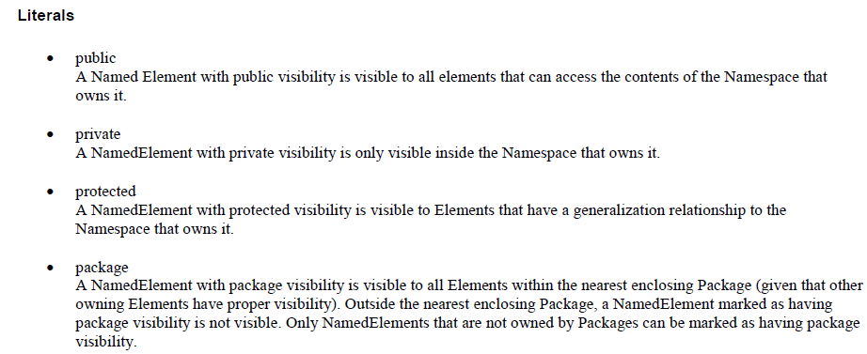
Summary
VisibilityKind is an enumeration type that defines literals to determine the visibility of Elements in a model.

Slide 46
Classification

Slide 47
Classifiers
Classification is an important technique for organization
Classifier, an abstract metaclass whose concrete subclasses are used to classify different kinds of values
A Classifier represents a classification of instances according to their Features
Classifiers are organized in hierarchies by Generalizations
RedefinableElements may be redefined in the context of Generalization hierarchies.

Slide 48
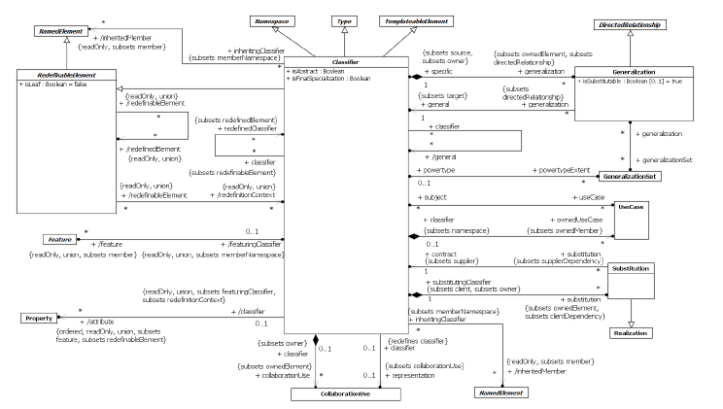
Abstract Syntax*
Recommendation : Please decipher this diagram only after understanding the semantics of each of the participating elements.

Slide 49
Classifiers
A Classifier has a set of Features, some of which are Properties called the attributes of the Classifier.
Each of the Features is a member of the Classifier
Values that are classified by a Classifier are called instances of the Classifier A Classifier may own CollaborationUses & Usecases

Slide 50
Generalization
Generalizations define generalization/specialization relationships between Classifiers
Each Generalization relates a specific Classifier to a more general Classifier.
Given a Classifier, the transitive closure of its general Classifiers is often called its generalizations
Transitive closure of its specific Classifiers is called its specializations
The immediate generalizations are also called the Classifier’s parents, and where the Classifier is a Class, its superClasses
An instance of a Classifier is also an (indirect) instance of each of its generalizations
When a Classifier is generalized, certain members of its generalizations are inherited, that is they behave as though they were defined in the inheriting Classifier itself

Slide 51
Generalization
Type conformance means that if one Type conforms to another, than any instance of the first Type may be used as the value of a TypedElement whose type is declared to be the second Type
The isAbstract property of Classifier, when true, specifies that the Classifier is abstract, i.e., has no direct instances: every instance of the abstract Classifier shall be an instance of one of its specializations.
If one Classifier (the parent) generalizes another (the child) it is not necessarily the case that instances of the child are substitutable for instances of the parent under every possible circumstance.
The isSubstitutable property may be used to indicate whether the specific Classifier can be used in every circumstance that the general Classifier can be used.
E.g. Circle substituting the Ellipse

Slide 52
Generalization
Any member (that is a kind of RedefinableElement) of a generalization of a specializing Classifier may be redefined instead of being inherited.
Redefinition is done in order to augment, constrain, or override the redefined member(s) in the context of instances of the specializing Classifier
specifically, any reference to a redefined member in the context of an instance of the specializing Classifier shall resolve to the redefining member
A Substitution is a relationship between two Classifiers which signifies that the substitutingClassifier complies with the contract specified by the contract Classifier.
Substitution dependency denotes runtime substitutability that is not based on specialization.
Unlike specialization, does not imply inheritance of structure, but only compliance of publicly available contracts
Interfaces implemented by the contract Classifier are also implemented by the substitutingClassifier or else the substitutingClassifier implements a more specialized Interface type.
isFinalSpecialization : If true, the Classifier cannot be specialized.

Slide 53
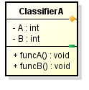
Generalization
Members that are inherited by a Classifier may be shown on a diagram of that Classifier by prepending a caret ’^’ symbol to the textual representation that would be shown if the member were not inherited. Thus the notation for an inherited Property is defined like this:
<inherited-property> ::= ’^’ <property>

Slide 54
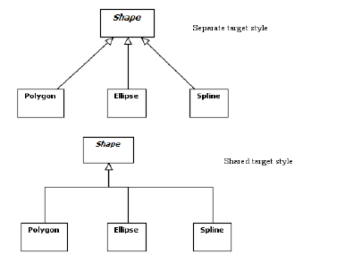

Examples
Generalization Notations
Substitution Notation

Slide 55
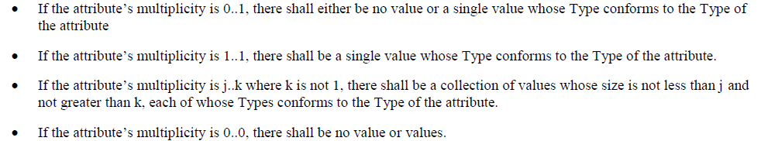
Features
Features represent structural and behavioral characteristics of Classifiers
The isStatic property specifies whether the characteristic relates to the Classifier’s instances considered individually (isStatic=false), or to the Classifier itself (isStatic=true) ; default = non-static
A StructuralFeature is a typed Feature of a Classifier that specifies the structure of instances of the Classifier
All of the StructuralFeatures of a Classifier that are Properties are called the attributes of the Classifier
For each instance of a Classifier there is a value or collection of values for each direct or inherited non-static attribute of the Classifier

Slide 56
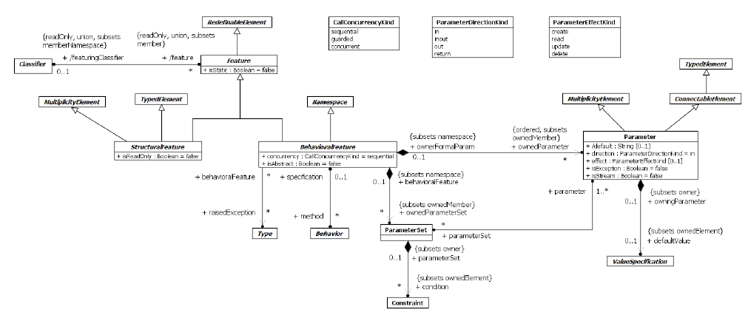
Abstract Syntax*
Recommendation : Please decipher this diagram only after understanding the semantics of each of the participating elements.

Slide 57
Features
A non-static BehavioralFeature specifies that an instance of its featuringClassifier will react to an invocation of the BehavioralFeature by carrying out a specific behavioral response
The list of ownedParameters describes the order, type, and direction of arguments that may be given when the BehavioralFeature is invoked, or which are output and returned when the invocation completes
A BehavioralFeature may raise an exception during its invocation
One way to define the behavioral response of a BehavioralFeature is to specify one or more Behaviors as methods that implement the BehavioralFeature
An invocation of the BehavioralFeature then results in the execution of one of the associated methods

Slide 58
Features
The isAbstract property, when true, specifies that the BehavioralFeature does not have any methods implementing it, with the expectation that an implementation will be supplied by a more specific element

Slide 59
Parameters
A Parameter is a specification of an argument used to pass information into or out of an invocation of a BehavioralFeature
The Type and Multiplicity of a Parameter restrict what values may be passed, how many, and whether the values are ordered
The Multiplicity defines a lower and upper bound on the values passed to the Parameter at runtime. A lower bound of zero means the Parameter is optional. A lower bound greater than zero means values for the Parameter are required to arrive sometime during the execution of the action.
If a defaultValue is specified for a Parameter, then it is evaluated at invocation time and used as the argument for this Parameter if and only if no argument is supplied at invocation of the BehavioralFeature.

Slide 60
Parameters
A Parameter may be given a name, which then identifies the Parameter uniquely within the Parameters of the same BehavioralFeature. If it is unnamed, it is distinguished only by its position in the ordered list of Parameters.
The direction property specifies whether a value is passed into, out of, or both into and out of the owning BehavioralFeature. Its type is ParameterDirectionKind, an enumeration of the following literal values:

Slide 61
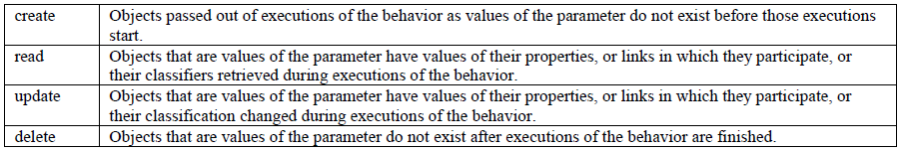
Parameters
The effect property may be used to specify what happens to objects passed in or out of a Parameter
Only in and inout Parameters may have a delete effect. Only out, inout, and return Parameters may have a create effect.
The isException property applies to output Parameters.
An output posted to a Parameter with isException true during an invocation of a BehavioralFeature excludes outputs from being posted to any other outputs of the BehavioralFeature during the same invocation
The isStream property, when true, designates a streaming Parameter.

Slide 62
Parameters
A ParameterSet owned by a BehavioralFeature is an element that provides alternative sets of inputs or outputs that the Behaviors that implements that BehavioralFeature may use
a ParameterSet with all inputs is called an input ParameterSet, and one with all outputs is called an output ParameterSet.
A BehavioralFeature with input ParameterSets may only accept inputs from Parameters in one of the sets per invocation. A BehavioralFeature with output ParameterSets may only return outputs to the Parameters in one of the sets per invocation.

Slide 63
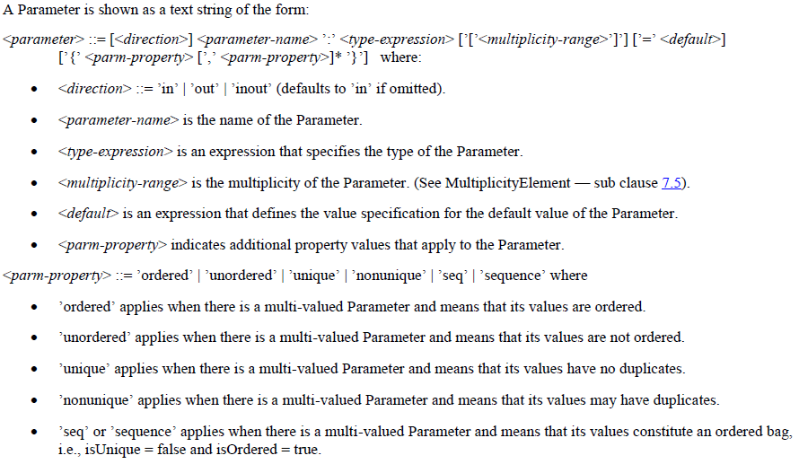
Parameters

Slide 64
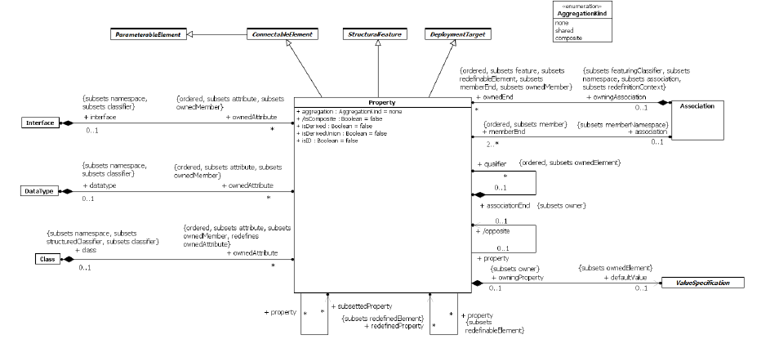
Properties
Properties are StructuralFeatures that represent the attributes of Classifiers, the memberEnds of Associations, and the parts of StructuredClassifiers

Slide 65
Properties
A Property may represent an attribute of a Classifier, a memberEnd of an Association, or in some cases both simultaneously.
A Property represents a declared state of one or more instances in terms of a named relationship to a value or values.
When a Property is a non-static attribute of a Classifier, the value or values are related to the instance of the Classifier by being held in slots of the instance.
When a Property is an Association’s memberEnd, the value or values are related to the instance or instances at the other end(s) of the association
When a Property is a static attribute of a Classifier, the value or values are related to the Classifier itself
When a Property is owned by a Classifier other than an Association via ownedAttribute, then it represents an attribute of the Classifier.
.

Slide 66
Properties
In either case, when instantiated a Property represents a value or collection of values associated with an instance of one (or in the case of a ternary or higher-order association, more than one) Classifier. This set of Classifiers is called the context for the Property; in the case of an attribute the context is the owning Classifier, and in the case of an association end the context is the set of Classifiers at the other end or ends of the Association.
If there is a defaultValue specified for a Property, this default is evaluated when an instance of the Property is created
If a Property has isDerived = true, it is derived and its value or values may be computed from other information

Slide 67
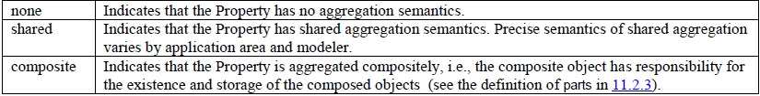
Properties
A derived Property may redefine one which is not derived
If a Property has a specified default, and the Property redefines another Property with a specified default, then the redefining Property’s default is used in place of the more general default from the redefined Property
One instance is used to group together a set of instances; this is called aggregation. Property has an aggregation property, of type AggregationKind which is an enumeration with the following literal values :
Composite aggregation is a strong form of aggregation that requires a part object be included in at most one composite object at a time. If a composite object is deleted, all of its part instances that are objects are deleted with it.

Slide 68
Properties
In either case, when instantiated a Property represents a value or collection of values associated with an instance of one (or in the case of a ternary or higher-order association, more than one) Classifier. This set of Classifiers is called the context for the Property; in the case of an attribute the context is the owning Classifier, and in the case of an association end the context is the set of Classifiers at the other end or ends of the Association.
If there is a defaultValue specified for a Property, this default is evaluated when an instance of the Property is created
If a Property has isDerived = true, it is derived and its value or values may be computed from other information

Slide 69
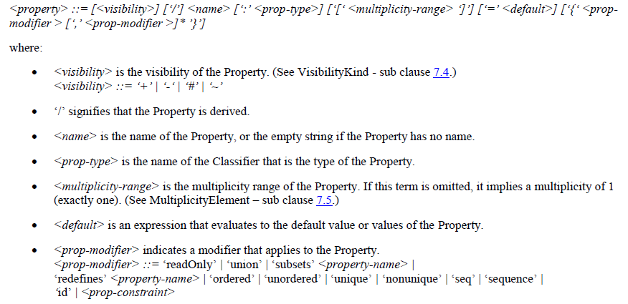
Properties

Slide 70

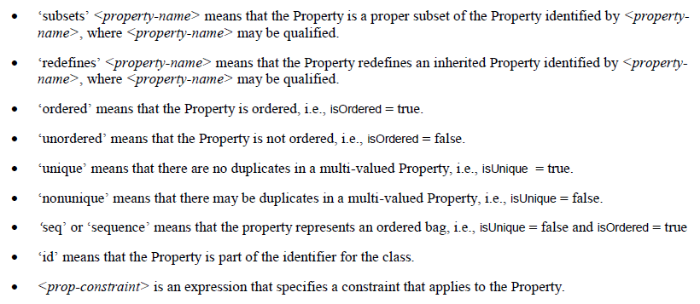
Properties

Slide 71
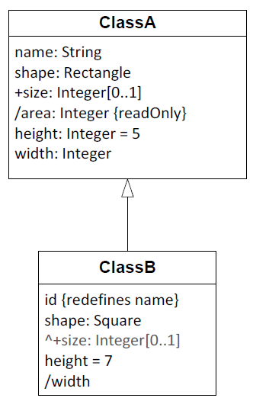

Properties : Examples

Slide 72
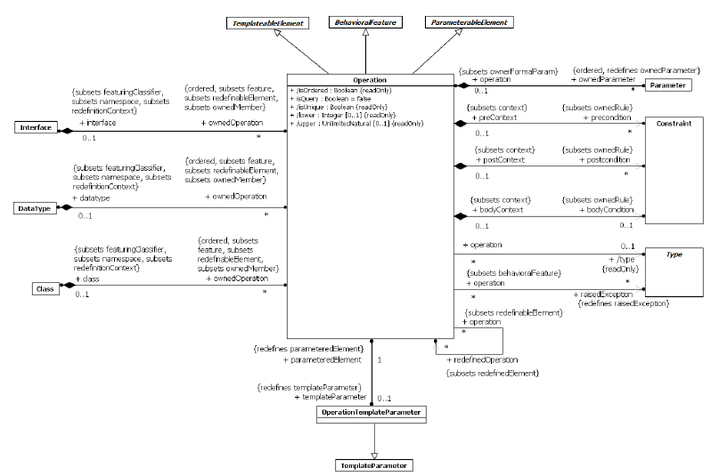
Operations
An Operation is a BehavioralFeature that may be owned by an Interface, DataType or Class

Slide 73
Operations
An Operation may be directly invoked on instances of its featuringClassifiers.
The Operation specifies the name, type, Parameters, and Constraints for such invocations.
If there is a return Parameter, the type of the Operation is the same as the type of this Parameter. Otherwise the Operation has no type.
The preconditions for an Operation define conditions that shall be true when the Operation is invoked
The postconditions for an Operation define conditions that will be true when the invocation of the Operation completes successfully
The bodyCondition for an Operation constrains the return result to a value calculated by the specification of the bodyCondition.
The bodyCondition differs from postconditions in that the bodyCondition may be overridden when an Operation is redefined, whereas postconditions may only be added during redefinition
An Operation may raise an exception during its invocation
An Operation may be redefined in a specialization of the featuringClassifier.

Slide 74

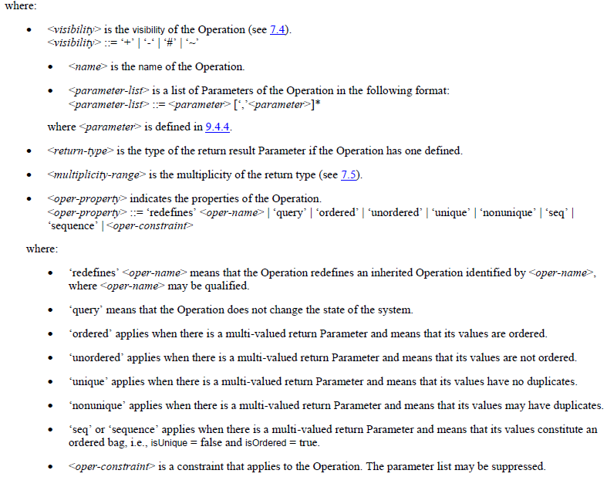
Operations
If the isQuery property is true, an invocation of the Operation shall not modify the state of the instance or any other element in the model.

Slide 75
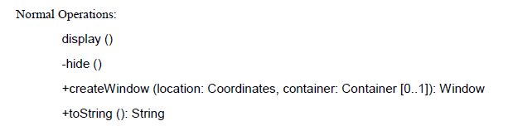
Operations : Examples

Slide 76
Instances
InstanceSpecifications represent instances of Classifiers in a modeled system.
A Slot specifies that an instance modeled by an InstanceSpecification has a value or values for a specific StructuralFeature
A direct attribute, inherited attribute, private attribute in a generalization, or a memberEnd if the classifier is an Association
The values in a Slot shall conform to the defining StructuralFeature of the Slot (in type, multiplicity, etc.)
The values in a Slot are specified using ValueSpecifications
The InstanceSpecification may represent:
Classification of the instance by one or more Classifiers
The kind of instance, based on its classifiers. For example, an InstanceSpecification whose classifier is a Class describes an instance of that Class, while an InstanceSpecification whose classifier is an Association describes a link of that Association.
Specification of values of StructuralFeatures of the instance, where the values are contained in Slots

Slide 77
Instances
An InstanceSpecification may specify the actual existence of an instance in a modeled system
An InstanceSpecification may represent an instance at a point in time (a snapshot)
An InstanceValue is a kind of ValueSpecification whose value is specified using an InstanceSpecification.
Any slots in the InstanceSpecification then provide values for the corresponding StructuralFeatures of the instance by evaluating the ValueSpecifications associated with those slots.
A StructuralFeature for which no slot is given either has the value obtained by evaluating its defaultValue, if it is a Property with a defaultValue, or no value, otherwise

Slide 78
Instances
An InstanceSpecification is depicted using similar notation to its classifiers, but in place of the Classifier name appears an underlined concatenation of the instance name (if any), a colon (‘:’) and the Classifier name or names.
An InstanceSpecification whose classifier is an Association represents a link
but the solid path or paths connect InstanceSpecifications rather than Classifiers
Standard notation for an anonymous InstanceSpecification of an unnamed Classifier is an underlined colon (‘:’).
If an InstanceSpecification has a ValueSpecification as its specification, the ValueSpecification is shown either after an equal sign
A Slot for that StructuralFeature may be shown textually as a StructuralFeature name or qualifiedName followed by an equal sign (‘=’) and a value specification.

Slide 79
Instances
A Slot value that is an InstanceValue may alternatively be shown using a graphical notation similar to that for a link. A solid path runs from the owning InstanceSpecification to the symbol representing the InstanceValue that is the Slot’s value

Slide 80



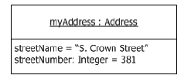

Instances : Examples

Slide 81
Summary
AggregationKind : Enumeration for specifying the kind of aggregation of a Property
BehavioralFeature : feature of a Classifier that specifies an aspect of the behavior of its instances. A BehavioralFeature is implemented (realized) by a Behavior. A BehavioralFeature specifies that a Classifier will respond to a designated request by invoking its implementing method.
CallConcurrencyKind : is an Enumeration used to specify the semantics of concurrent calls to a BehavioralFeature.
Classifier : represents a classification of instances according to their Features.
Feature : declares a behavioral or structural characteristic of Classifiers.
Generalization : is a taxonomic relationship between a more general Classifier and a more specific Classifier. Each instance of the specific Classifier is also an instance of the general Classifier. The specific Classifier inherits the features of the more general Classifier. A Generalization is owned by the specific Classifier

Slide 82
Summary
InstanceSpecification : is a model element that represents an instance in a modeled system
InstanceValue : ValueSpecification that identifies an instance.
Operation : is a BehavioralFeature of a Classifier that specifies the name, type, parameters, and constraints for invoking an associated Behavior. An Operation may invoke both the execution of method behaviors as well as other behavioral responses.
Parameter : is a specification of an argument used to pass information into or out of an invocation of a BehavioralFeature
ParameterDirectionKind : is an Enumeration that defines literals used to specify direction of parameters.
ParameterEffectKind : is an Enumeration that indicates the effect of a Behavior on values passed in or out of its parameters
ParameterSet : designates alternative sets of inputs or outputs that a Behavior may use.

Slide 83
Summary
Property : is a StructuralFeature. Related by ownedAttribute to a Classifier (other than an association) represents an attribute and might also represent an association end.
RedefinableElement : is an element that, when defined in the context of a Classifier, can be redefined more specifically or differently in the context of another Classifier that specializes (directly or indirectly) the context Classifier
Slot : designates that an entity modeled by an InstanceSpecification has a value or values for a specific StructuralFeature
StructuralFeature : is a typed feature of a Classifier that specifies the structure of instances of the Classifier
Substitution : is a relationship between two classifiers signifying that the substituting classifier complies with the contract specified by the contract classifier. This implies that instances of the substituting classifier are runtime substitutable where instances of the contract classifier are expected

Slide 84
Reference :
Chapter 7,9 of the UML 2.5 Specification

